Slide 1
NORmalising METeorology on Air Quality
Congbo Song
Senior Research Scientist in Data Science and Analytics in Atmospheric Air Pollution, National Centre for Atmospheric Science (NCAS)

Slide 2
Motivation: Why?
Methodology: How?
Intro to ‘normet’

Slide 3
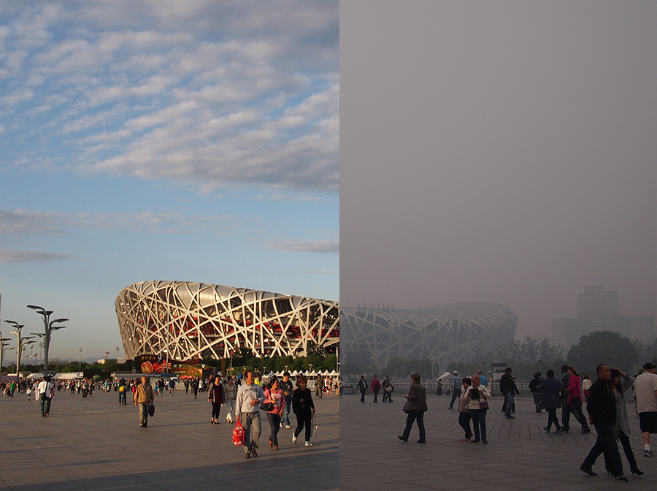
Human effort or luck from nature? Motivation
APEC blue (Chinese: APEC蓝) refers to the rare blue sky in Beijing during APEC China 2014 due to emission reduction campaign directed by Chinese government.
Attribution of APEC blue: emission reduction or favorable meteorology?
Beijing National Stadium, during and after APEC 10-12 Nov 2014

Slide 4
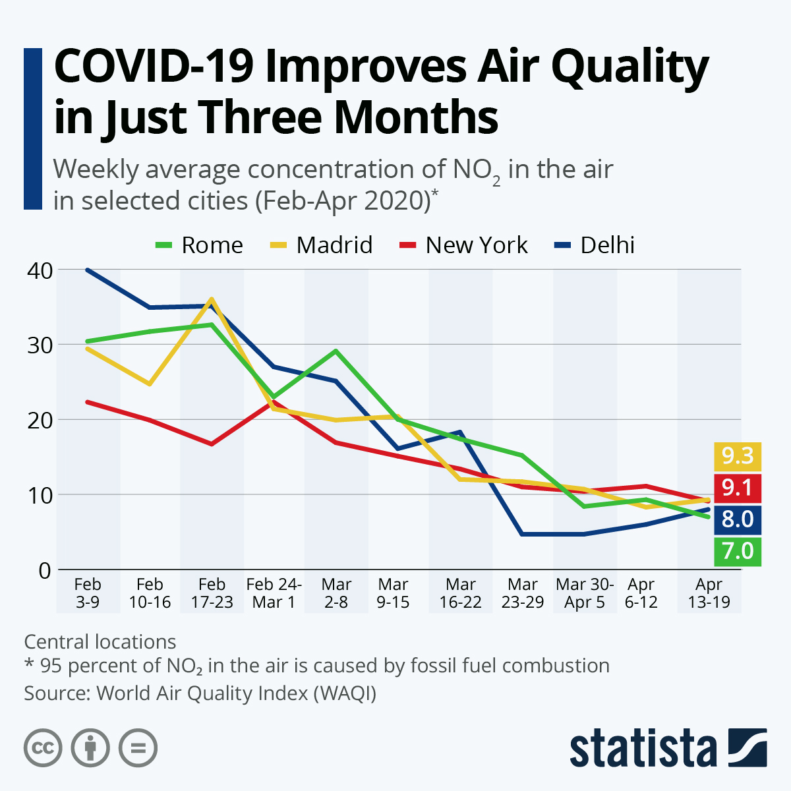
Human effort or luck from nature? Motivation
COVID-19 lockdowns
Unique opportunity of large-scale natural experiment to examine the response of air quality to ceased human activities.
Major cities around the world saw improvements in air quality during COVID-19 lockdown.

Slide 5
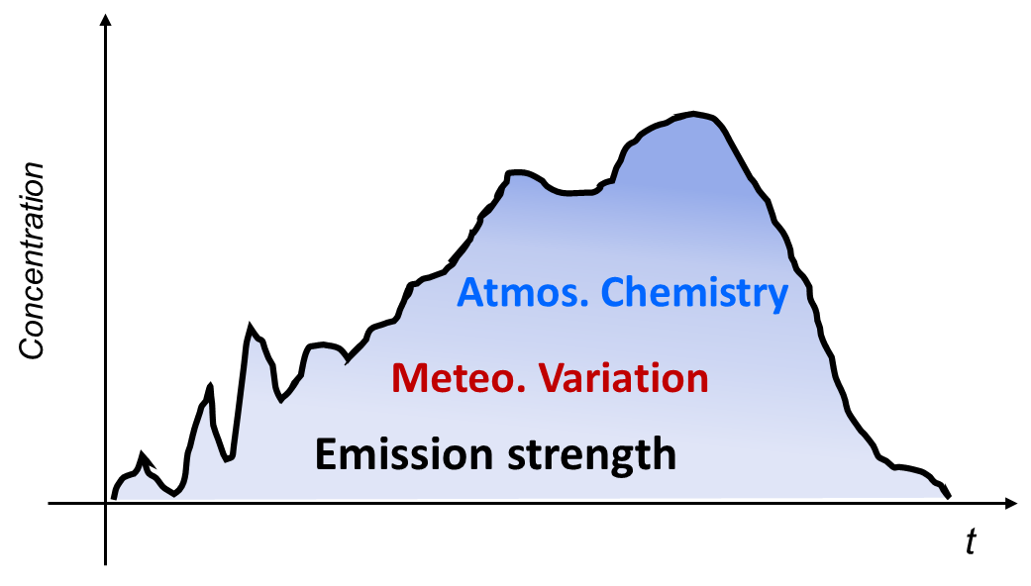
Human effort or luck from nature? Motivation
Adjusting meteorology (and chemistry) from observation is essential for intervention and accountability studies.
Air pollution is a function of emissions, meteorology and chemistry.
Essentially, no way to have air pollution without meteorology.
Interactions between air pollution and meteorology are much complicated (nonlinear).

Slide 6


Decoupling emission from meteorology Methodology
$${Obs}_{\left(t\right)}=f\left(E_{t}\right)+f\left(M_{t}\right)$$
Obs changes:
$${Obs}_{\left(t2\right)}−{Obs}_{\left(t1\right)}=f\left(E_{t2}\right)−f\left(E_{t1}\right)+f\left(M_{t2}\right)−f\left(M_{t1}\right)$$
Attributed to emission changes
Attributed to meteorology changes
The key is to fix meteorology impacts

Slide 7
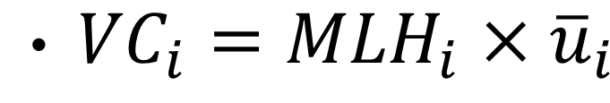
Decoupling emission from meteorology Methodology
Chemical Transport Modelling with fixed meteorology.
1) emissions inventories,
2) bias in meteorological prediction, and
3) lack of sufficient chemical production mechanisms.
Dispersion-normalised concentration using Ventilation Coefficient.
VC cannot consider other meteorological parameters

Slide 8
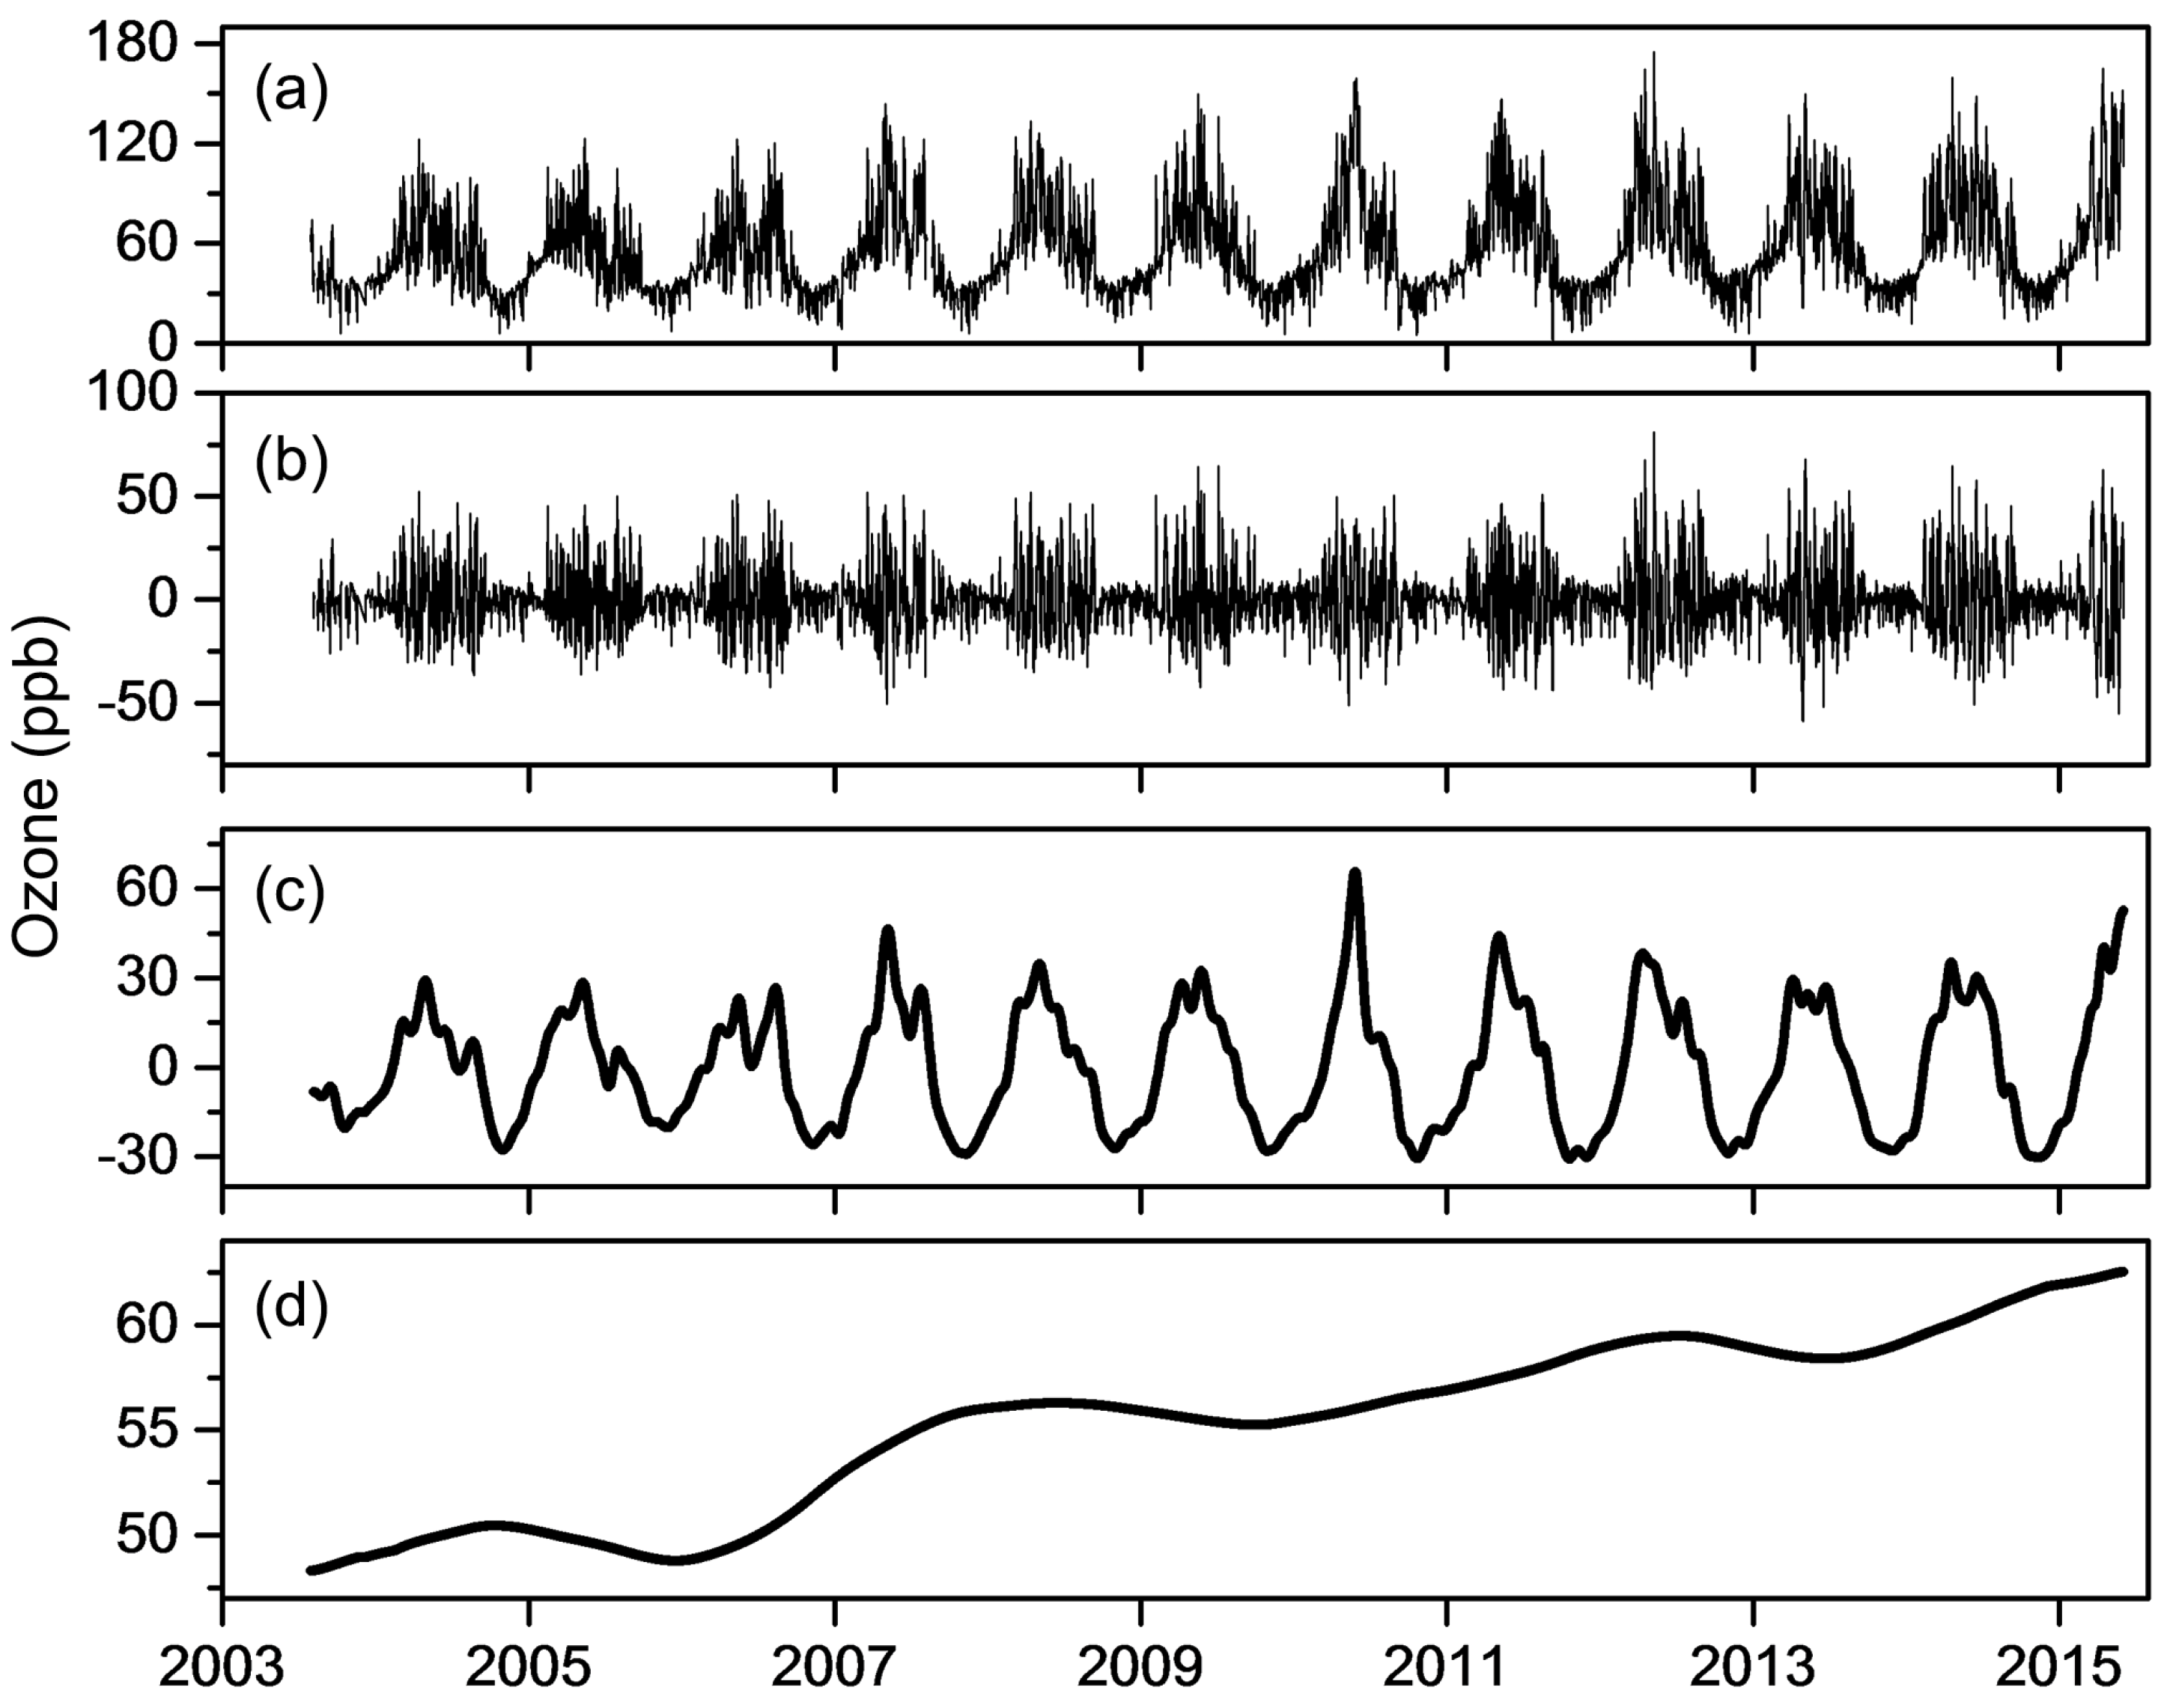
Decoupling emission from meteorology Methodology
Time series decomposition
KZ_{m,p :} p iterations of a moving average of length m
O(t)=W(t)+S(t)+e(t)
O(t) : the original time series
W(t) : the mesoscale and synoptic-scale variation
S(t) : the seasonal change
e(t) : the long-term (trend) component.
W(t)=O(t)−KZ_{15,5},
S(t) = KZ_{15,5} − KZ_{365,3},
e(t) = KZ_{365,3}
Cannot fully distinguish EMI and MET-related components.
Rao, S.T. and Zurbenko, I.G., 1994. Detecting and tracking changes in ozone air quality. Air & waste, 44(9), pp.1089-1092.

Slide 9
Decoupling emission from meteorology Methodology
Statistical regression modelling
Cannot well resolve the non-linear response problem.
The model performance generally not as good as expected, and Critical assumptions on data.
Difficult to consider interactions/collinearity between different MET parameters

Slide 10
Decoupling emission from meteorology Methodology
NORmalising METeorology on Air Quality
First build a predictive model for reproducing concentrations with time variables and meteorological parameters.
Averaging multiple predictions derived from different meteorological conditions with fixed emissions for a given measurement.
Predictive models achieved via Machine Learning algorithm – AutoML

Slide 11
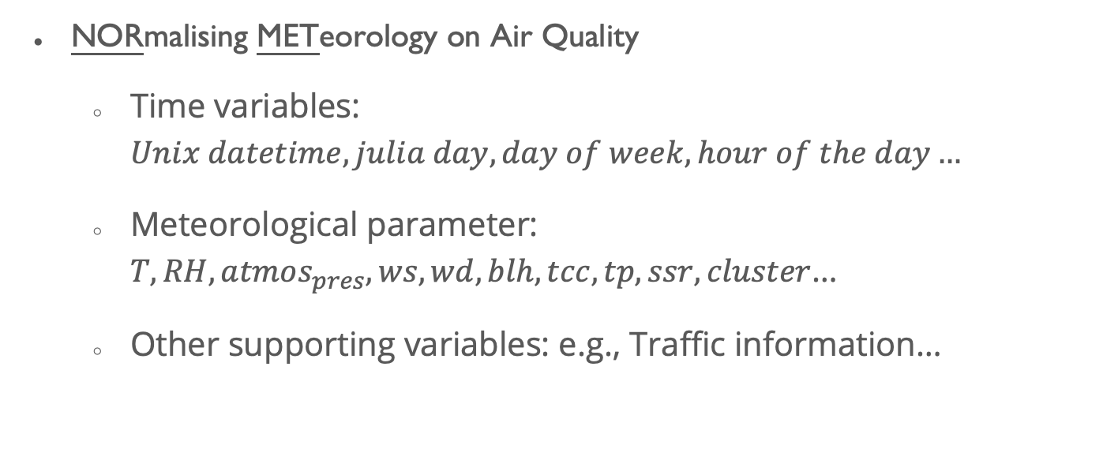
Decoupling emission from meteorology Methodology
NORmalising METeorology on Air Quality
Time variables: $Unix datetime,julia day, day of week, hour of the day…$
Meteorological parameter: $T, RH, atmos_{pres},ws, wd,blh,tcc, tp, ssr,cluster$…
Other supporting variables: e.g., Traffic information…

Slide 12
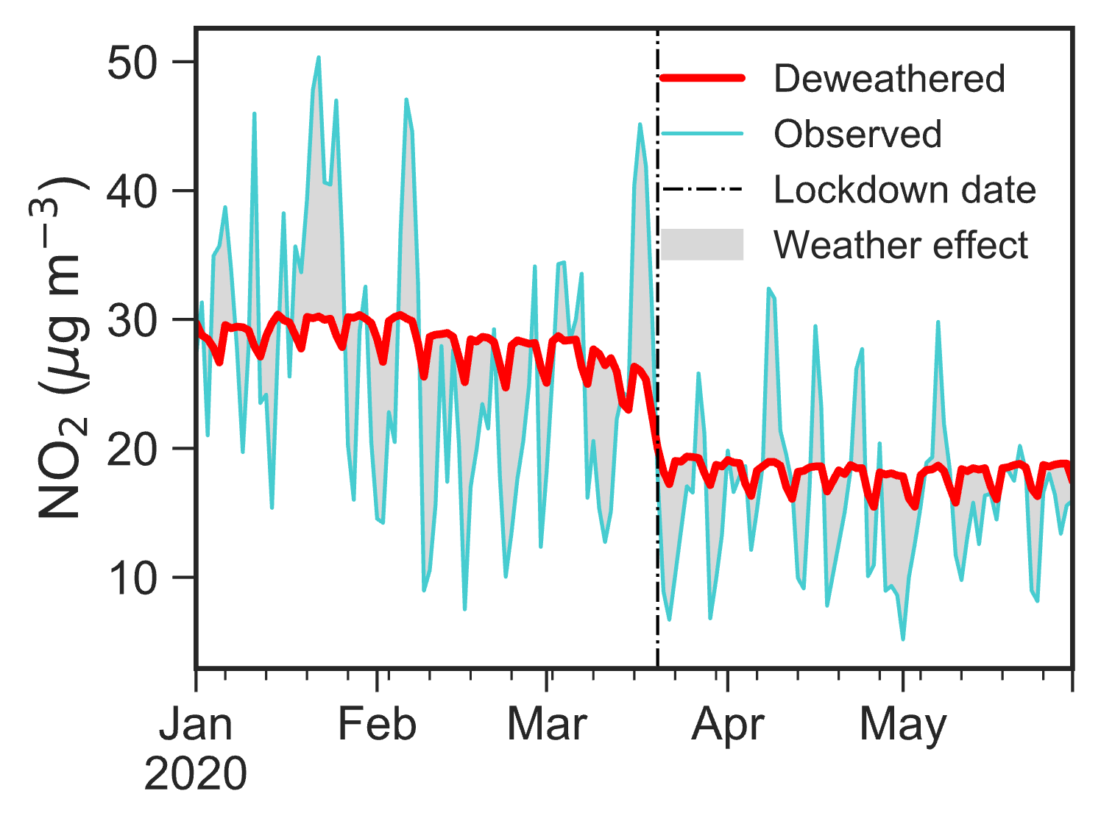

Decoupling emission from meteorology Methodology
Weather normalised concentrations give us EMI-related air quality changes, which is directly linked to air quality policy interventions.
Shi and Song et al., Sci. Adv., 2021

Slide 13
Intro to ‘normet’
Comparing to existing popular packages/toolkit for weather normalisation
 | rmweather | deweather | normet
Language | R | R | Python and R
Model | Random Forest Model | Generalized Boosted Regression Model | Automatic ML Python (FLAML) R (H2O)
Hyperparameters | No tunning | Simple tunning | Automatic tunning
Weather shuffling | Whole dataset | Whole dataset | Whole dataset or user-defined weather dataset
Time cost | 18.68mins | >18.68mins | 4.39mins

Slide 14
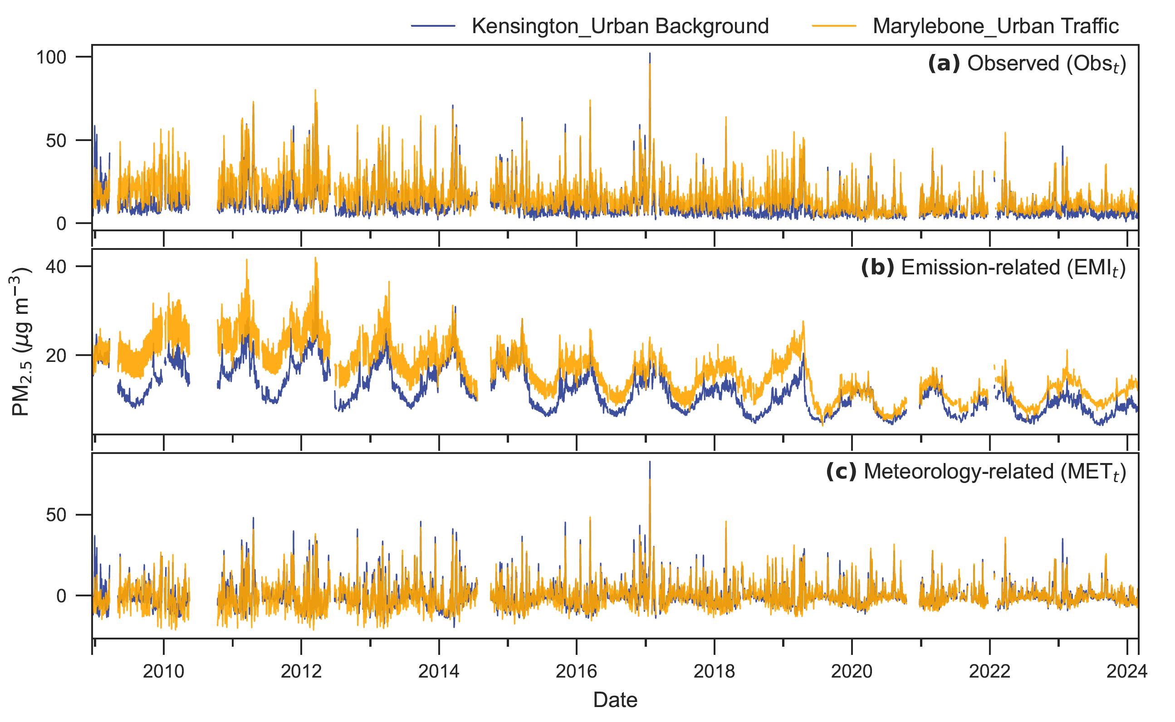
Intro to ‘normet’

Slide 15
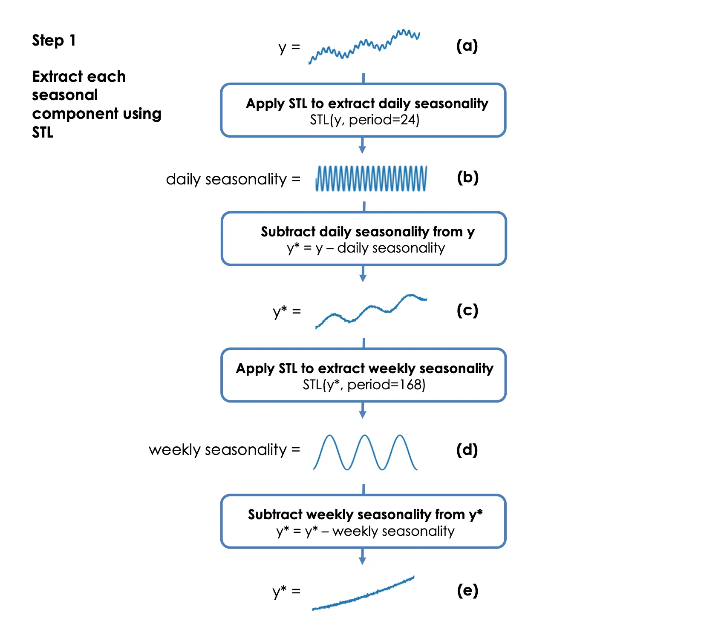
Intro to ‘normet’
Air quality time series decomposition using interactive subtraction
Exclude Params | Shuffle Params | Normalisation | Seasonality
'hour' | MET Params+ 'weekday','day_julian','date_unix' | Norm₁ | Hour of day: Norm₁-Mean(Obs)
'hour', 'weekday' | MET Params+'day_julian','date_unix' | Norm₂ | Day of week: Norm₂-Norm₁
'hour', 'weekday’, 'day_julian' | MET Params+ 'date_unix' | Norm₃ | Day of year: Norm₃-Norm₂
'hour', 'weekday’, 'day_julian’, 'date_unix' | MET Params | Norm₄ =Dew | Trend: Norm₄-Norm₃+Mean(Obs)

Slide 16
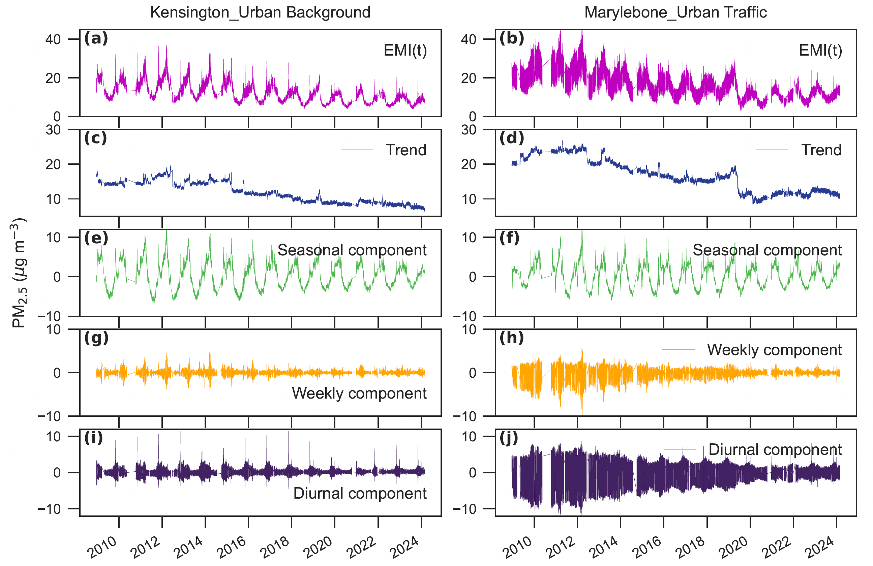
Intro to ‘normet’
Air quality time series decomposition

Slide 17
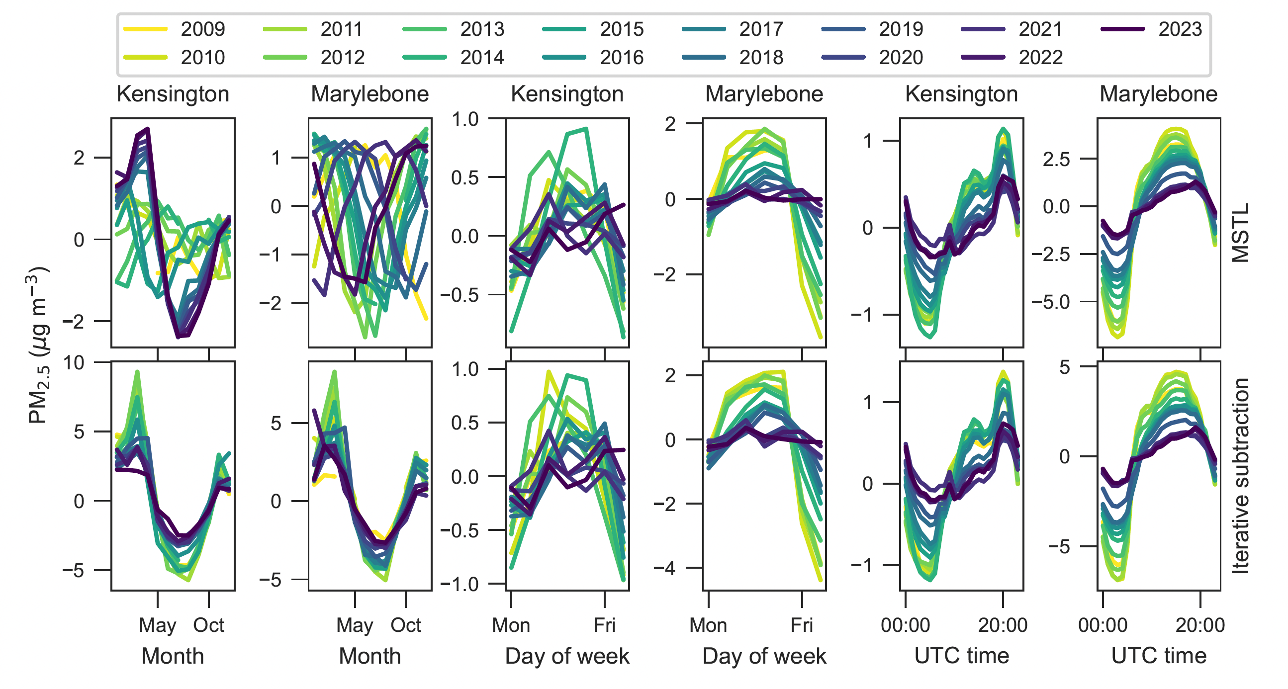
Intro to ‘normet’
Changes in time profiles for emissions

Slide 18
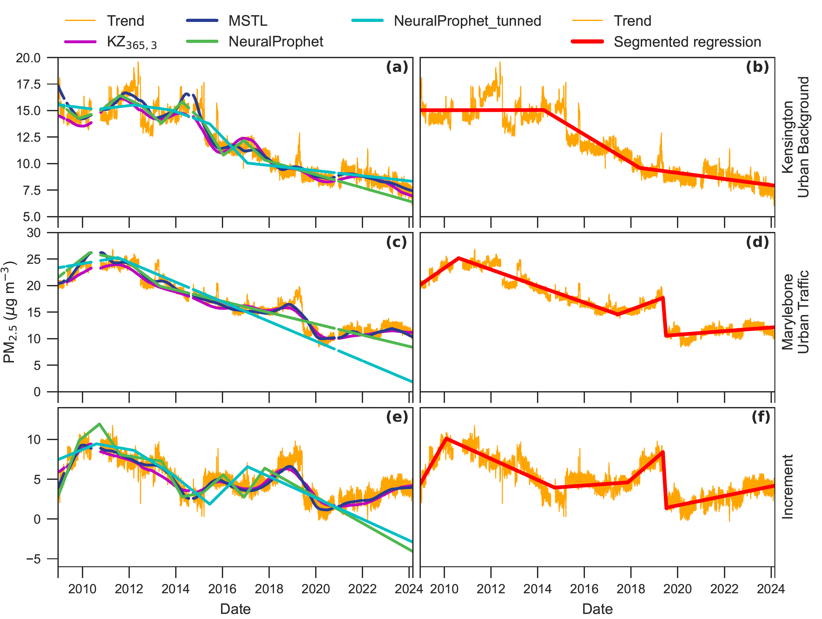
Intro to ‘normet’
Long-term trend extracted from different approaches

Slide 19
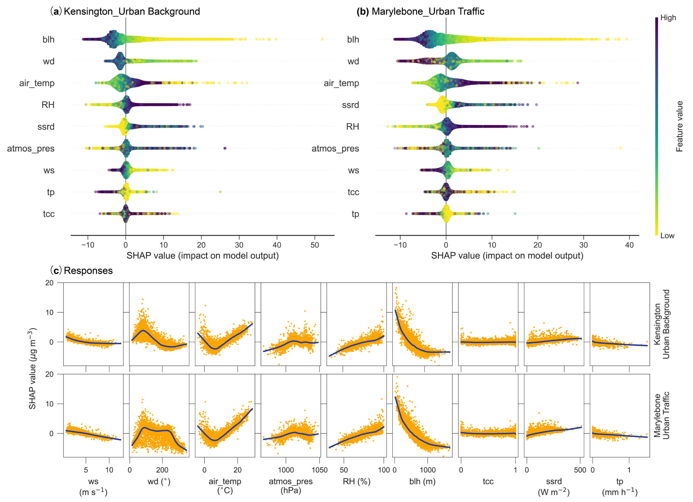
Intro to ‘normet’
Decomposition of the MET component using explainable ML

Slide 20
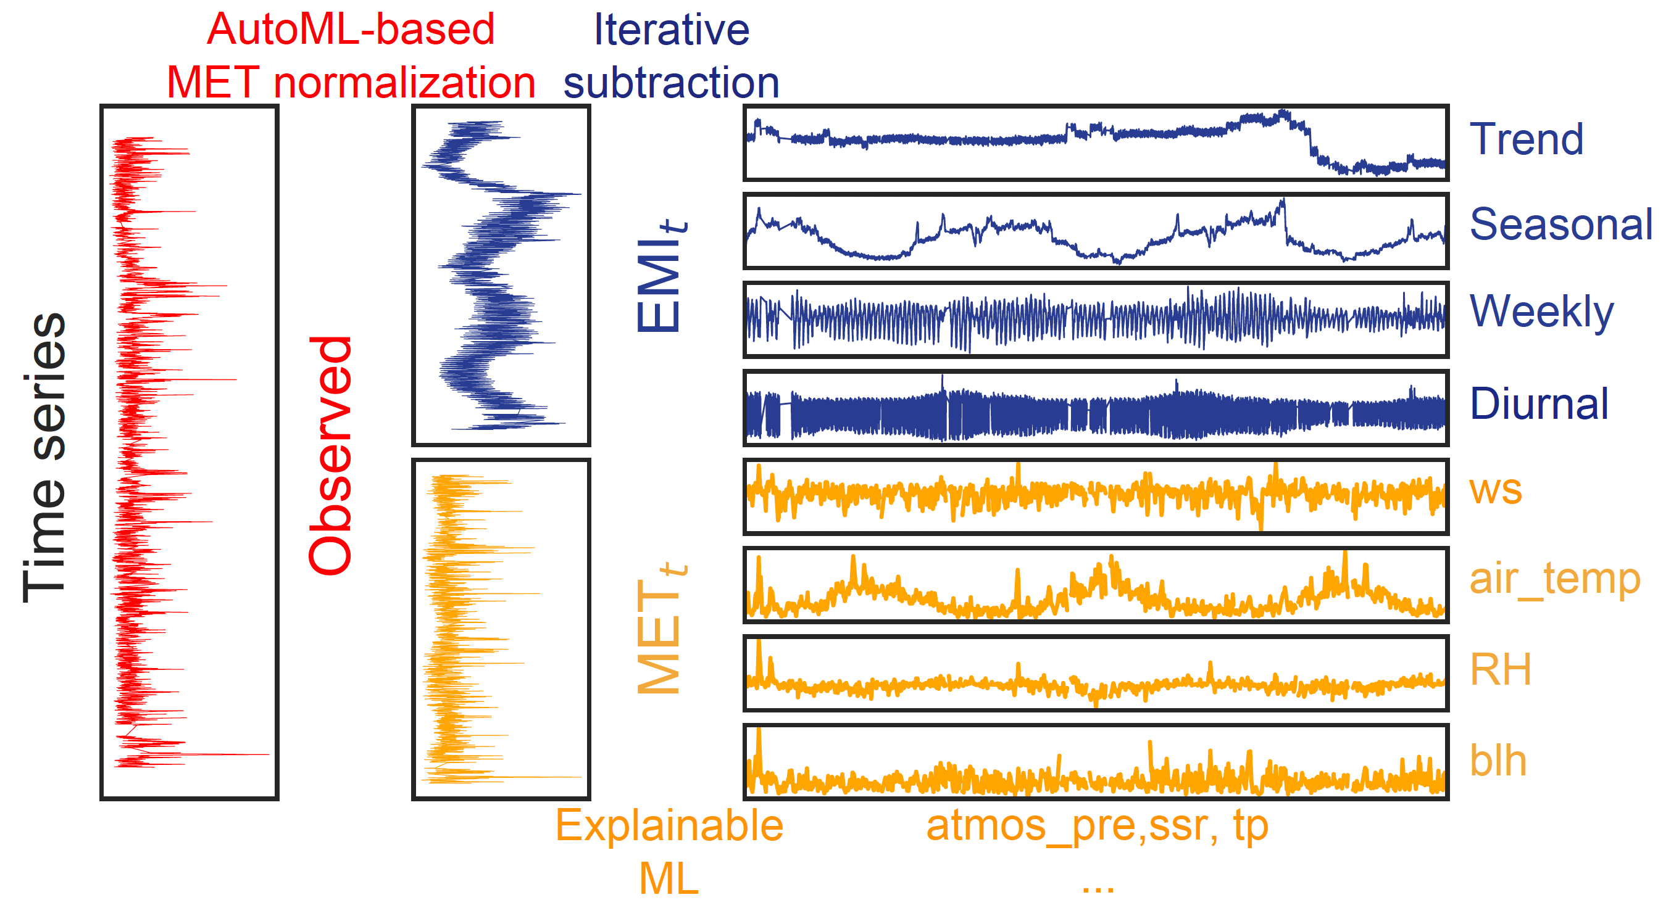
Intro to ‘normet’

Slide 21
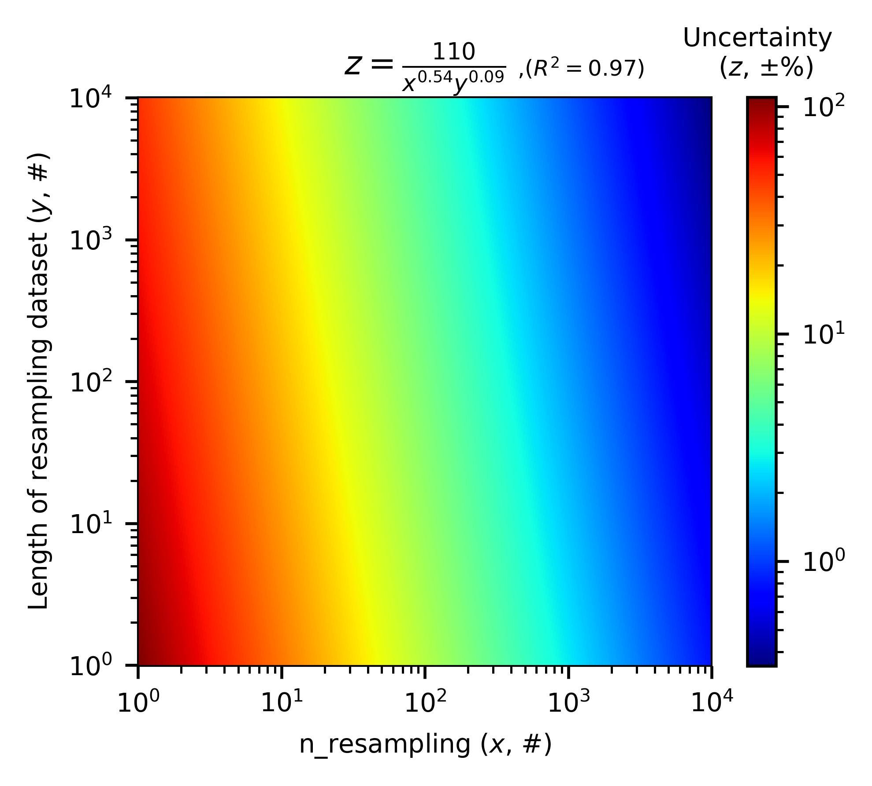
Intro to ‘normet’
Something to consider:
Optimal model → AutoML
Resampling variables → Depending on decomposition components you are interested in.
Sampling times → Depending on acceptable uncertainty

Slide 22
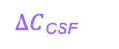
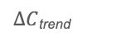
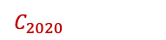
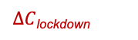

Intro to ‘normet’
Emission
1st-2nd weeks
before the CSF
Transition
1st-2nd weeks
after transition
Something to consider:
Other variables: lunar day,
type-specific traffic counts
Holiday
C_{pre}
$∆C$_{trend}
C_{CSF,BAU}
C_{after}
$$C_{2015−2019}$$
$∆C$_{CSF}
$$C_{2020}$$
C_{CSF}
$∆C$_{lockdown}
C_{lockdown}
Week
-3 -2 -1 1 2 3 4
Chinese New Year Eve
Geophysical Research Letters, 48(11), p.e2021GL093403.

Slide 23
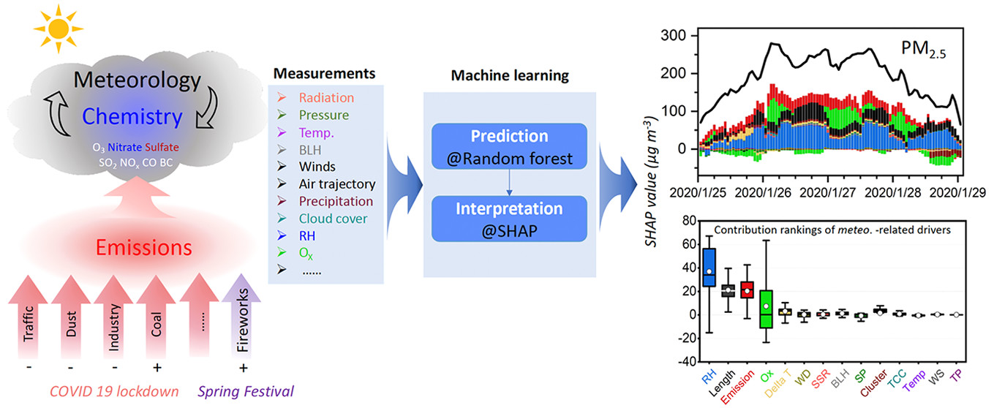
Intro to ‘normet’
Something to consider:
Combining weather normalization with other data science techniques
Environ. Sci. Technol. Lett. 2022, 9, 2, 112–119

Slide 24
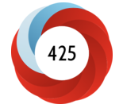
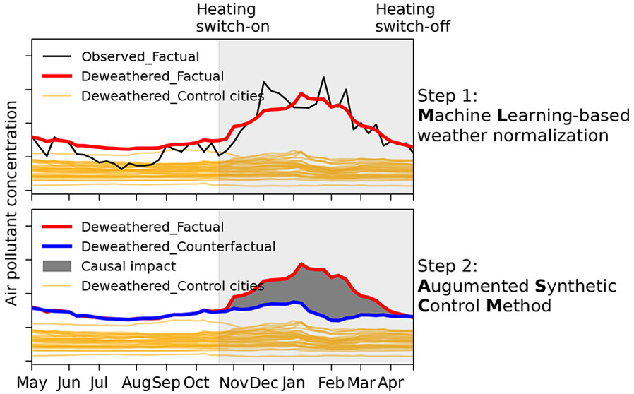
Intro to ‘normet’
Environ. Sci. Technol. 2023, 57, 46, 17707–17717
Something to consider:
Combining weather normalization with other data science techniques

Slide 25

Summary
Light-weighted AutoML
Better model and 4×faster computing
Fully AQ time series decomposition
On both R and Python platform

